Slide 1

Welcome to the App modernization Webinar
The session will start at 09:00 GTM+2

Slide 2
App modernization

Slide 3


Presenters
Kristinn Tyr Gunnarsson
Solidify (Denmark)
Kristinn.gunnarsson@solidify.dev
https://www.linkedin.com/in/kristinn-gunnarsson-devops-consultant/
Senior DevOps Engineer & CEO Solidify Denmark

Slide 4

Presenters
Mihai Borz Solidify (Stockholm)
Mihai.borz@solidify.se
https://www.linkedin.com/in/mihaiborz/
Senior Software Engineer

Slide 5


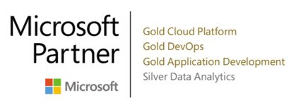
What is Solidify
Solidify is a leading Scandinavian DevOps Consultancy focused on the Microsoft Stack. With over 25 experts in four countries ready to help you with your DevOps Journey.

Slide 6
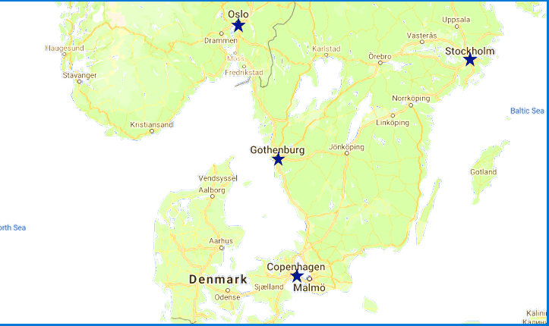
Locations
Notes:
Solidify has offices in Stockholm, Gothenburg , Oslo and Denmark.
Solidify also has one employee in Estonia.

Slide 7
Solidify Mission Statement
Our customers create value using software. We help them do it faster, at lower cost and with the right quality.

Slide 8


https://solidify.dev/
https://www.linkedin.com/company/solidify-dev
https://github.com/solidify
@solidifyse
https://www.youtube.com/channel/UChHumq_I3ne3nnoQ0B_KNgQ?sub_confirmation=1
Notes:
https://solidify.dev/
https://www.linkedin.com/company/solidify-dev
https://github.com/solidify
@solidifyse
https://www.youtube.com/channel/UChHumq_I3ne3nnoQ0B_KNgQ?sub_confirmation=1

Slide 9
Agenda
09:00
Start of day, introductions
09:30
Review the customer case study
09:40
Walkthrough, design solution
09:50
Break
10:50
Break
11:45 – 12:00
Introduction to HOL & Wrap up
10:00
Ppurposed solution Deep dive
11:00
Ppurposed solution continued

Slide 10




Hello audience
Dev
Ops
Project management
Other
(bandit)
(nerdy)
(emo)
(think)

Slide 11
Introduction Application Modernization and Azure Basic Concepts.

Slide 12

Abstract and learning objectives
In this whiteboard design session, you work with a group to design a solution for modernizing legacy on-premises applications and infrastructure by leveraging cloud services. As part of the modernization effort, application enhancements are added using a mix of web and mobile services, all secured using Azure Active Directory.
At the end of this whiteboard design session, your ability to design a modernization plan for organizations looking to move services from on-premises to the cloud will be improved.

Slide 13
Step 1: Review the customer case study
Outcome
Analyze your customer needs.
Timeframe
15 minutes

Slide 14

Customer situation
Contoso, Ltd. provides a full range of long-term insurance services to help underinsured people.
They are trying to cope with being overloaded due to faster-than-expected growth.
Notes:
Contoso Ltd. is a new company in a very old business. Founded in Auckland, New Zealand, in 2005, by senior life insurance executives, the ambitious new company provides a full range of long-term insurance services to help people who are underinsured.
Almost from the start, the company grew far faster than anticipated. An avalanche of business meant that the original processes created to manage policy documentation became overloaded. Employees struggled to cope, even as the headcount rose from five to 110 during the first year.

Slide 15

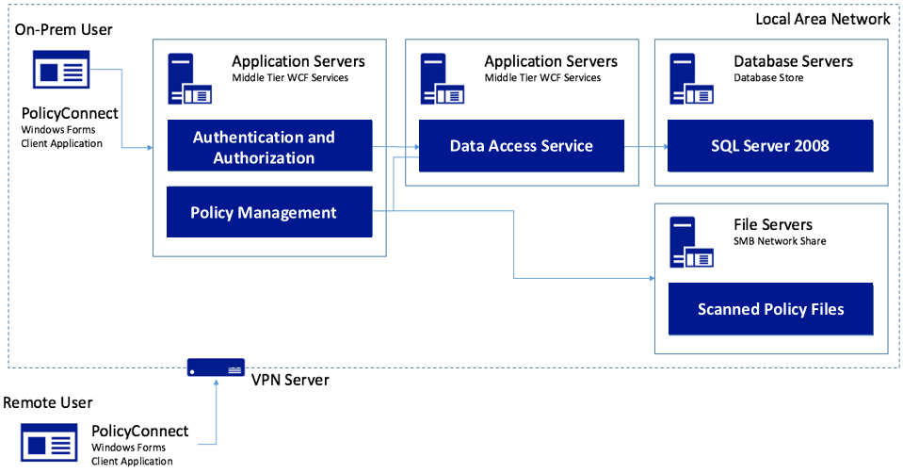
Customer situation - 2
Contoso, Ltd. created a custom Windows Forms app called PolicyConnect for their employees to manage policy holder information.
Their data is stored in a SQL Server 2008 database, and a file server on their local area network.
Notes:
Contoso Ltd. implemented PolicyConnect, a custom Windows Forms application used by their staff to input key metadata that includes policy holder information such as insured amount, beneficiary, policy type, and any deductible and out of pocket requirements.
Contoso employees access this application which ultimately stores its data in a SQL Server 2008 database, and a file server on their local area network.

Slide 16



Customer situation - 3
Employees rely on email as a workflow engine for document management tasks.
Would like options to gain insights without requiring custom development each time.
Wants to make policy holder system available through web and mobile applications without VPN.
Notes:
Contoso employees rely on email as a workflow engine relative to the document management tasks. They are using Office 365.
Executive leadership have frequent challenges in gauging productivity and throughput given the manual workflow—they feel that are blocked in quickly getting to the insights they need because each new question seems to need more custom development.
Wants to make their policy holder system available to its employees and brokers via web and mobile applications without requiring VPN, and store policies in cloud storage for retrieval via the new apps.
They would like to migrate their SQL Server based database to SQL Database

Slide 17




Customer situation - 4
We would like to make sure our database isn’t overtaxed, show a dashboard with user statistics, allow non-developers in other departments to make mobile apps, and improve security by protecting application secrets.
Can you help us do this?
Notes:
Want to ensure they employ best practices for mitigating the impact of repeated querying of the database
Looking to implement a scoreboard of sorts that tracks the most active users in a 24-hour period, as well as approximate the number of operations that user performed with the system in perpetuity
Want to make sure they have a streamlined way for internal departments to quickly build their own apps to automate time saving micro-processes without having to involve the PolicyConnect development team or ideally, even developers
Improve security by externalizing secrets such as connection strings from the web apps and APIs, and storing them in an encrypted location accessible only to authorized services
Contoso has multiple development teams and is concerned about duplication of effort and change management as they move more business logic to APIs. They also are considering opening a subset of APIs to a network of affiliated partners.

Slide 18






Customer needs - 5
Modernize our architecture
Go mobile
Enable non-developer employees to create apps
Improve management of app secrets
Add cognitive search
Use serverless API technologies
Migrate to fully-managed SQL database service
Add caching to our solution

Slide 19

Customer objections
How can we automate our processes?
Will Microsoft Flow replace Logic Apps?
Is there really a way to securely store application secrets in the cloud?
We won’t have all of the SQL features available to us in the cloud.
Our API inventory will grow, and we are concerned about how to best manage that.
Wants to understand how choose correct .NET framework

Slide 20
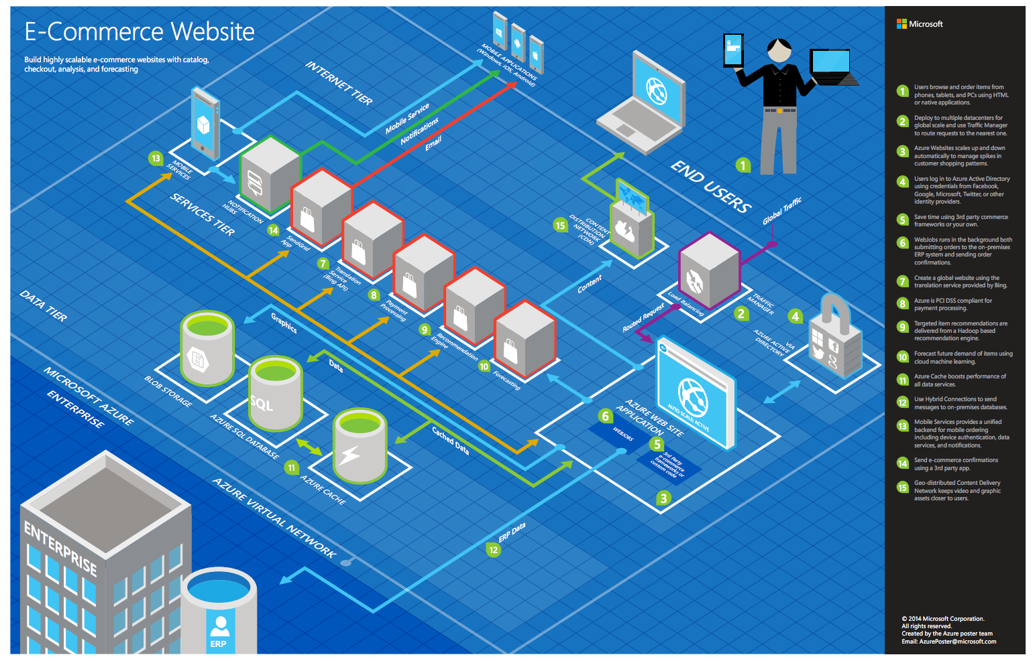
Common scenarios
Notes:
This is a diagram of a common architecture for this type of scenario, that you can draw inspiration from. You will find this diagram within the learner guide.

Slide 21
Step 2: Design the solution
Outcome
Design a solution and prepare to present the solution to the target customer audience in a 15-minute chalk-talk format.
Timeframe
60 minutes
Business needs (10 minutes) | Respond to questions outlined in your guide and list the answers on a flipchart.
Design (35 minutes) | Design a solution for as many of the stated requirements as time allows. Show the solution on a flipchart.
Prepare (15 minutes) | Identify any customer needs that are not addressed with the proposed solution. Identify the benefits of your solution. Determine how you will respond to the customer’s objections. Prepare for a 15-minute presentation to the customer.

Slide 22
Step 3: Present the solution
Outcome
Present a solution to the target customer in a 15-minute chalk-talk format.
Timeframe
30 minutes (15 minutes for each team to present and receive feedback)
Directions
Pair with another table.
One table is the Microsoft team and the other table is the customer.
The Microsoft team presents their proposed solution to the customer.
The customer asks one of the objections from the list of objections in the case study.
The Microsoft team responds to the objection.
The customer team gives feedback to the Microsoft team.

Slide 23
Wrap-up
Outcome
Identify the preferred solution for the case study. Identify solutions designed by other teams.
Timeframe
15 minutes

Slide 24

Preferred target audience
Charlene Mathis, General Manager, Contoso Ltd
The primary audience is business and technology decision makers.
Usually we talk to the Infrastructure Managers who report into the CIOs, or to application sponsors (like a VP LOB, CMO) or to those that represent the Business Unit IT or developers that report into application sponsors.

Slide 25
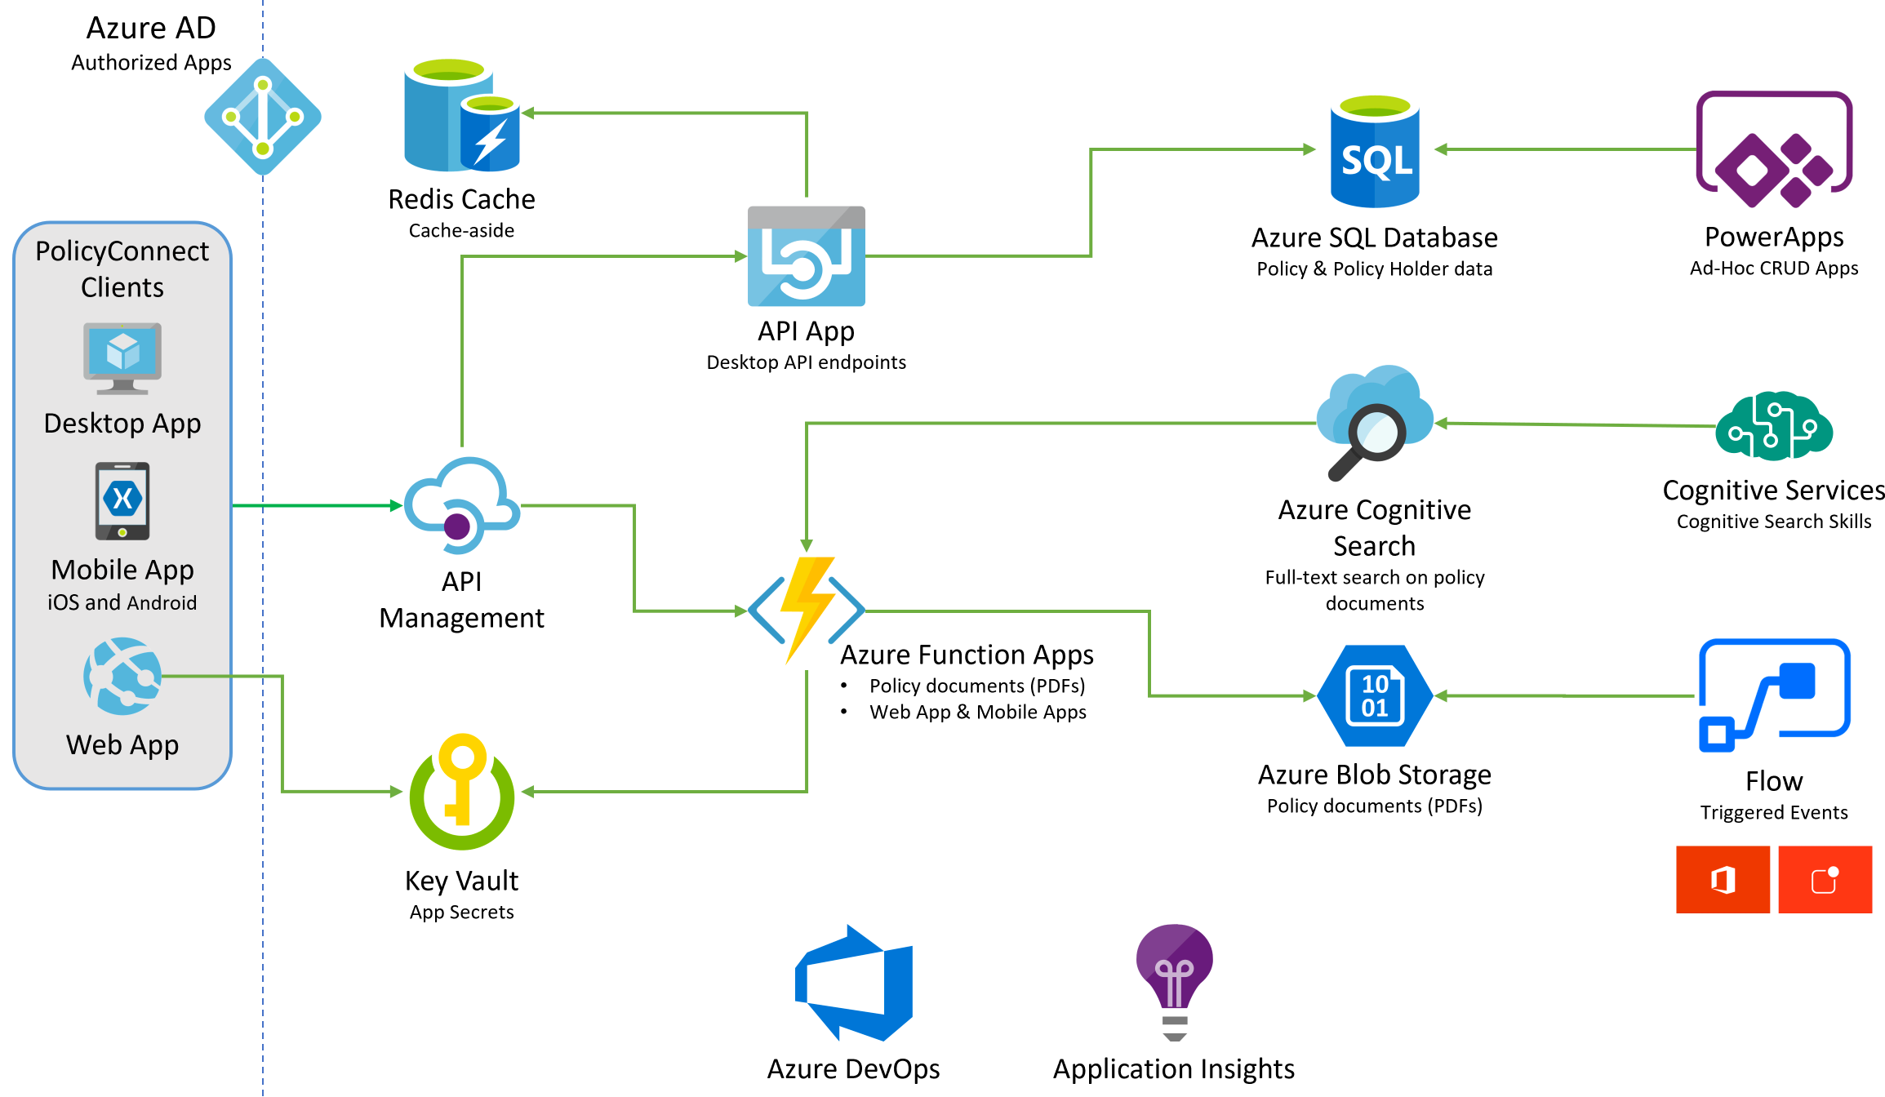
Preferred solution
Notes:
The solution begins with migrating Contoso's SQL Server 2008 R2 database to Azure SQL Database using the Azure Database Migration Service. After performing an assessment using the Data Migration Assistant, Contoso was able to determine that there were no compatibility issues or unsupported features to prevent them from migrating into a fully-managed SQL database service in Azure. Next, the web and API apps are migrated into Azure App Services. In addition, mobile apps, built for Android and iOS using Xamarin, are created to provide access to PolicyConnect. The website, hosted in a Web App, provides the user interface for browser-based clients, whereas the Xamarin Forms-based apps provide the UI to mobile devices. Both the mobile app and website rely on web services hosted in a Function App, which sits behind API Management. An API App is also deployed to host APIs for the legacy Windows Forms desktop application. Light-weight, serverless APIs are provided by Azure Functions and Azure Functions Proxies to provide access to the database and policy documents stored in Blob Storage. Azure API Management is used to create an API Store for development teams and affiliated partners. Sensitive configuration data, like connection strings, are stored in Key Vault and accessed from the APIs or Web App on demand so that these settings never live in their file system. The API App uses the Azure Redis Cache to implement the cache aside pattern, caching data as it is retrieved from SQL Database. A full-text cognitive search pipeline is used to index policy documents in Blob Storage. Cognitive Services are used to enable search index enrichment using cognitive skills in Azure Cognitive Search. PowerApps enable authorized business users to build mobile and web create, read, update, delete (CRUD) applications that interact with SQL Database and Azure Storage, while Microsoft Flow enables them to orchestrations between services such as Office 365 email and services for sending mobile notifications. These orchestrations can be used independently of PowerApps or invoked by PowerApps to provide additional logic. The solution uses user and application identities maintained in Azure AD.

Slide 26
BREAK

Slide 27
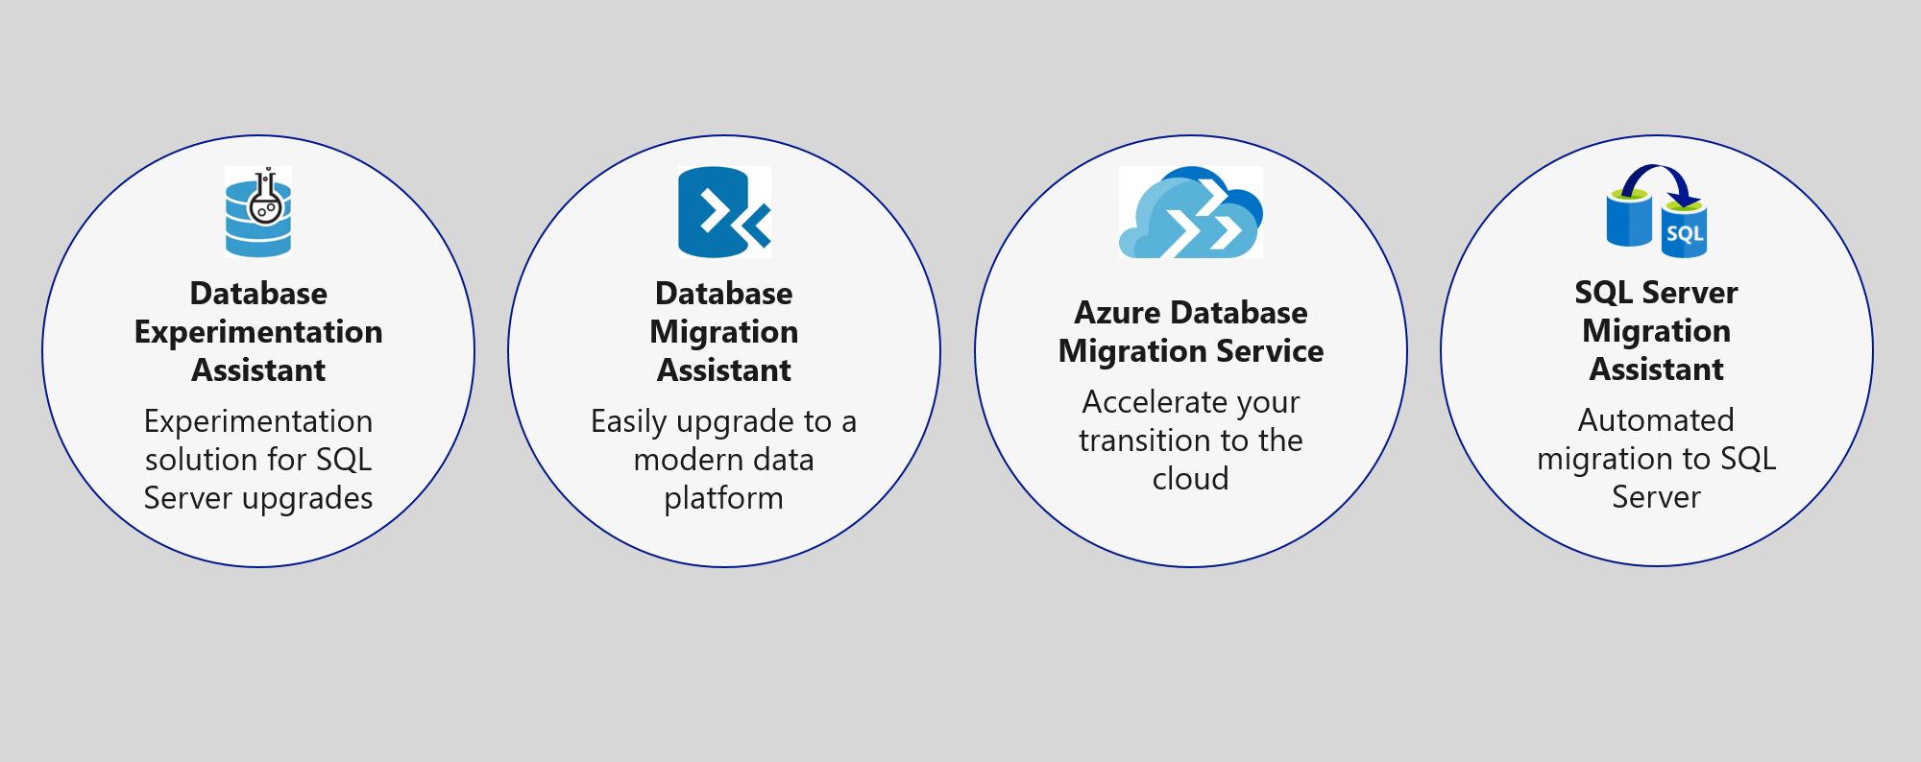
Preferred solution - 1
Data Management
Migrate database to Azure SQL using Database Migration Service

Slide 28
Database Management
For large applications consider using SQL Server Replication(Push subscription) to Azure.
For multiple small databases that have unpredictable usage demands consider using elastic pools (https://docs.microsoft.com/en-us/azure/azure-sql/database/elastic-pool-overview)
Consider using Code-first to manage your database solution in .net core where the database changes are deployed with your application and the application will make sure your application is up2date.

Slide 29
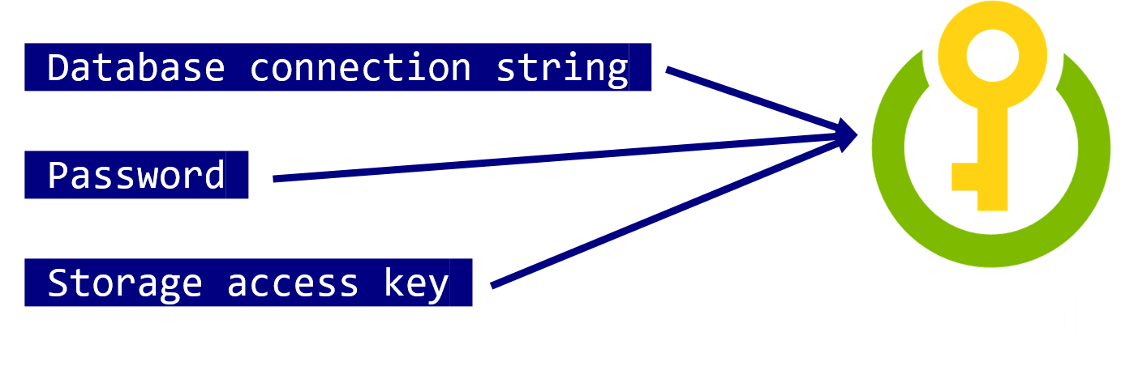
Preferred solution - 2
Mobile and Web Applications
Use Key Vault to store sensitive application secrets like database connection strings.
Notes:
How would you secure sensitive information used by the web site and APIs?
- Rather than storing sensitive application secrets like credentials and database connection strings in the web.config of the Web and API Apps, Contoso should use Key Vault to store these secrets

Slide 30
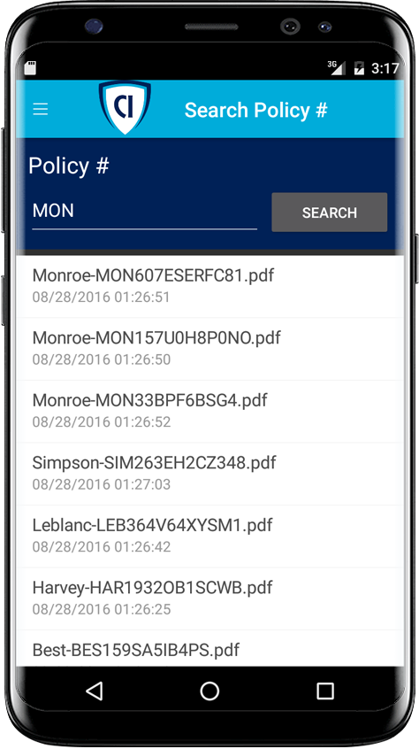

Preferred solution - 3
Storage and Search
Enable full-text search of policy documents with Azure Cognitive Search.
Azure Cognitive Search + Indexer for Azure Storage blobs
Notes:
Given their requirements, how would you enable full text search on the stored policy documents?
- Use Azure Cognitive Search and the Indexer for Azure Storage blobs.
- For files stored in Azure Storage Blobs, this indexer will full-text index PDFs, Microsoft Office Documents (DOCX, DOC, XLSX, XLS, PPTX, PPT and MSG), HTML, XML, ZIP, EML, JSON, and plain text files. They could then use the Azure Cognitive Search .NET SDK from the API App to kick off searches.

Slide 31

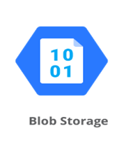
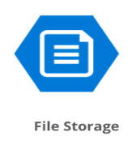
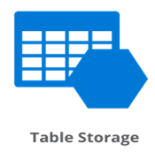
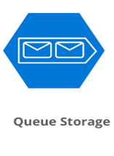
Azure Storage
Storage Account

Slide 32
Types of storage accounts
General-purpose v2 accounts: Basic storage account type for blobs, files, queues, and tables. Recommended for most scenarios using Azure Storage.
General-purpose v1 accounts: Legacy account type for blobs, files, queues, and tables. Use general-purpose v2 accounts instead when possible.
BlockBlobStorage accounts: Storage accounts with premium performance characteristics for block blobs and append blobs. Recommended for scenarios with high transactions rates, or scenarios that use smaller objects or require consistently low storage latency.
FileStorage accounts: Files-only storage accounts with premium performance characteristics. Recommended for enterprise or high performance scale applications.
BlobStorage accounts: Legacy Blob-only storage accounts. Use general-purpose v2 accounts instead when possible.

Slide 33
Access Tire and Replication
Access Tire
Hot - Optimized for storing data that is accessed frequently.
Cold - Optimized for storing data that is infrequently accessed and stored for at least 30 days.
Archive - Optimized for storing data that is rarely accessed and stored for at least 180 days with flexible latency requirements (on the order of hours).
Replication
LRS - Locally redundant storage replicates your data three times within a single physical location in the primary region.
ZRS - Zone-redundant storage replicates your Azure Storage data synchronously across three Azure availability zones in the primary region.
GRS - Geo-redundant storage copies your data synchronously three times within a single physical location in the primary region using LRS. It then copies your data asynchronously to a single physical location in the secondary region.
GZRS - Geo-zone-redundant storage combines the high availability provided by redundancy across availability zones with protection from regional outages provided by geo-replication.
Notes:
Note that with Archive you will have to request access to your files and that is done by changing the storage from archive to hot or cold
LRS replication with in the same data center.
ZRS replaction between three datacenters within the same region.
GRS LRS with between different regions

Slide 34
Blob Storage
Scalable service for text and binary data
Ideal for
Static images and documents
Video and Audio Streaming
Backup storage for hot and cold backups

Slide 35
Blob Storage
Accounts
Containers
Blobs
images
schema.jpg
SolidifyLabs
Png/flow.png
documents
Labs.pdf
3 to 24 characters
0-9 and a-z
Unique within Azure
3 to 63 characters
0-9, a-z, and dashes
1 to 1,024 characters
Any characters (including slashes)
URL characters must be escaped
Max. 254 path segments

Slide 36
File Storage
File shares (SMB) in a storage account
If you don’t need SMB use Blob storage
Notes:
Is primarily used for VM’s

Slide 37
Queues
Storage queues are used for messaging and are designed to hold vast amount of messages. Each message can be up to 64k. Storage Queues are ideal for event driven applications and applications that have the need for post-processing.

Slide 38
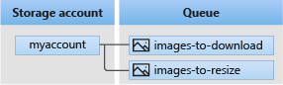
Queues
A sample would be to upload an image in a web app and have a serverless function resize the image after upload(post upload event).
The queue would then have message that the function would pick up and find for example a URI to the image in a storage account.

Slide 39
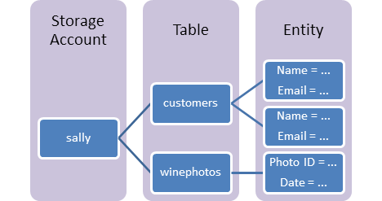
Table Storage
A NoSQL store for schema less storage of structured data.
Notes:
here is now a premium offering for table storage: the Azure Cosmos DB Table API. This API offers throughput-optimized tables, global distribution, and automatic secondary indexes. There are some feature differences between Table API in Azure Cosmos DB and Azure table storage. For more information, and to try out the premium experience, see Azure Cosmos DB Table API.
URL format: Azure Table Storage accounts use this format: http://<storage account>.table.core.windows.net/<table>
Azure Cosmos DB Table API accounts use this format: http://<storage account>.table.cosmosdb.azure.com/<table>
You can address Azure tables directly using this address with the OData protocol. For more information, see OData.org.
Accounts: All access to Azure Storage is done through a storage account. For more information about storage accounts, see Storage account overview.
All access to Azure Cosmos DB is done through a Table API account. See Create a Table API account for details creating a Table API account.
Table: A table is a collection of entities. Tables don't enforce a schema on entities, which means a single table can contain entities that have different sets of properties.
Entity: An entity is a set of properties, similar to a database row. An entity in Azure Storage can be up to 1MB in size. An entity in Azure Cosmos DB can be up to 2MB in size.
Properties: A property is a name-value pair. Each entity can include up to 252 properties to store data. Each entity also has three system properties that specify a partition key, a row key, and a timestamp. Entities with the same partition key can be queried more quickly, and inserted/updated in atomic operations. An entity's row key is its unique identifier within a partition.
For details about naming tables and properties, see Understanding the Table Service Data Model.

Slide 40
Storage And Searching
DEMO

Slide 41
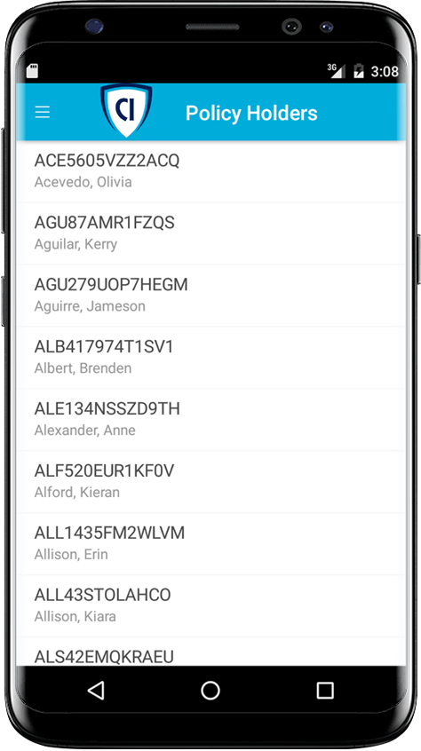



Preferred solution - 4
Mobile and Web Applications
Build mobile with Xamarin*
Use an API App for the back-end
Host web site with a Web App
Use Azure Functions Proxies
Notes:
How should Contoso implement the PolicyConnect mobile app?
- Utilize Xamarin within Visual Studio
What Azure service would host the services supporting the mobile app backend? Would you suggest a Mobile App or an API App? Why?
- In this scenario, either one would work because API Apps and Mobile Apps expose the same functionality that Contoso needs to support the Web App and the APIs that are behind the Web App and the Xamarin mobile application.
What Azure service would host the web site?
- A Web App
What Azure service would provide a light weight, serverless API solution for retrieving policy documents from Azure blob storage?
- Azure Functions Proxies provide an easy way to create serverless APIs, providing a way to break large APIs into multiple function apps (as in a microservices architecture), while still presenting a single API surface for clients.

Slide 42
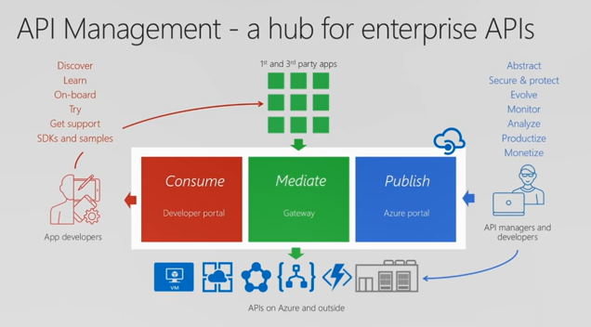

Preferred solution - 4
API Management
Contoso should use Azure API Management now to put together a proof of concept solution.
Azure API Management
Notes:
What recommendations can you make to help Contoso manage its API inventory as it grows in the future? Are there services in Azure that can provide a proof of concept *API Store* experience now and serve as path to development in the future?- Azure API Management has features to help Contoso quickly build and scale an API ecosystem and grow into the future. APIs can be organized into Product groups to provide organization and AAD integration comes out of the box. It will be relatively easy to develop new customer channels for affiliated partners and provide controlled discoverability and lifecycle management to development teams.

Slide 43
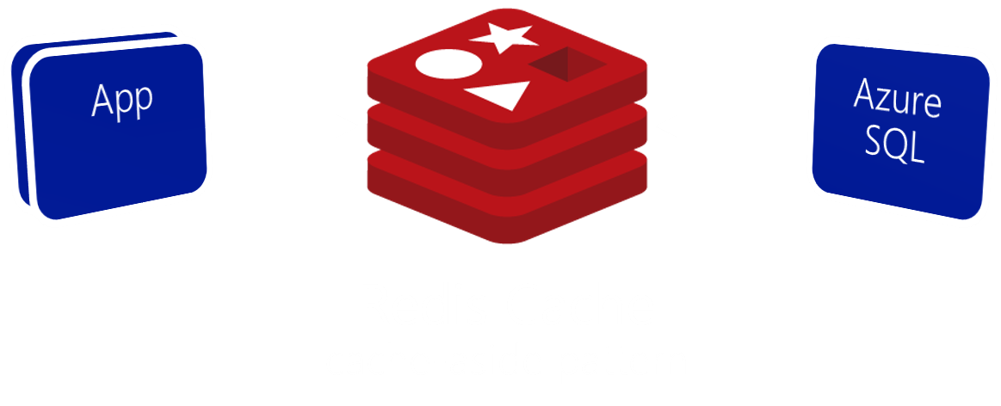
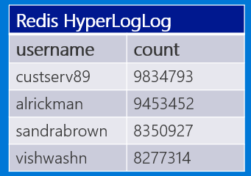
Preferred solution - 5
Data management
Use Azure Redis Cache to reduce load on database and implement scoreboards.
Scoreboard using HyperLogLog
Notes:
What patterns and services would you use to reduce load on the database? Implement the scoreboards?
- Use Azure Redis Cache and the cache-aside pattern.
- Check Azure Redis Cache is first on data requests. Return cached copy if exists, fetch from SQL Database if not, then save to Redis Cache.
- Scoreboards can also be implemented with Azure Redis Cache due to support for fast atomic incrementing of the values for any given string key (e.g., the key would be the username, the value the count). To reduce memory requirements for very large counts, use Redis’ HyperLogLog to store the counted value for each user key.
----------------------------------------------------------------------------------------
- In this approach, as data items are requested, the Azure Redis Cache is first checked to see if it exists there (if it is, then the cached copy is returned). Failing that, the application makes a request directly against SQL Database, but while returning the result to the client it also adds the data item into the Redis Cache.
- Scoreboards can be implemented effectively using Azure Redis Cache because of its support for fast atomic incrementing of the values for any given string key (e.g., the key would be the username, the value the count). To reduce memory requirements for very large counts (such as is possible collecting transaction counts per user in perpetuity), they could use Redis’ HyperLogLog to store the counted value for each user key. The HyperLogLog approximates the cardinality of a set the approximates the count of the number of unique items added (with an error rate less than 1%), and uses a fixed size of 12KB.

Slide 44

Preferred solution - 5
Logging with Application Insights
Use Azure Application Insights to monitor how our application is doing.
Notes:
What patterns and services would you use to reduce load on the database? Implement the scoreboards?
- Use Azure Redis Cache and the cache-aside pattern.
- Check Azure Redis Cache is first on data requests. Return cached copy if exists, fetch from SQL Database if not, then save to Redis Cache.
- Scoreboards can also be implemented with Azure Redis Cache due to support for fast atomic incrementing of the values for any given string key (e.g., the key would be the username, the value the count). To reduce memory requirements for very large counts, use Redis’ HyperLogLog to store the counted value for each user key.
----------------------------------------------------------------------------------------
- In this approach, as data items are requested, the Azure Redis Cache is first checked to see if it exists there (if it is, then the cached copy is returned). Failing that, the application makes a request directly against SQL Database, but while returning the result to the client it also adds the data item into the Redis Cache.
- Scoreboards can be implemented effectively using Azure Redis Cache because of its support for fast atomic incrementing of the values for any given string key (e.g., the key would be the username, the value the count). To reduce memory requirements for very large counts (such as is possible collecting transaction counts per user in perpetuity), they could use Redis’ HyperLogLog to store the counted value for each user key. The HyperLogLog approximates the cardinality of a set the approximates the count of the number of unique items added (with an error rate less than 1%), and uses a fixed size of 12KB.

Slide 45
DEMO

Slide 46
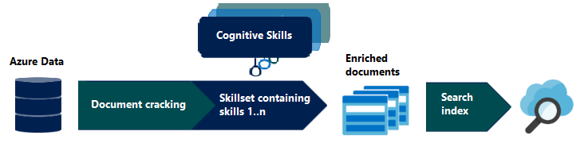
Preferred solution - 8
Search
Enrich search index with Cognitive Search

Slide 47

Preferred solution - 9
Search
Custom cognitive skills
Azure Cognitive Search + Functions

Slide 48

Preferred solution - 10
Extensibility
Enable business users to create their own internal mobile apps using PowerApps.
They can use Microsoft Flow to create ad-hoc automated processes.
Notes:
How would you enable their business users to create their own internal mobile apps that help them streamline their processes without the time and resource investment required for full scale mobile apps?
- PowerApps would enable business users at Contoso to create their own web and mobile apps that support CRUD functionality against data in SQL DB and Azure Storage Blobs.
- Microsoft Flow, which integrates with PowerApps but can also be used stand-alone, would enable them to create automated processes in ad-hoc fashion. Business users could create these for their own use or share them back with the rest of the organization.

Slide 49
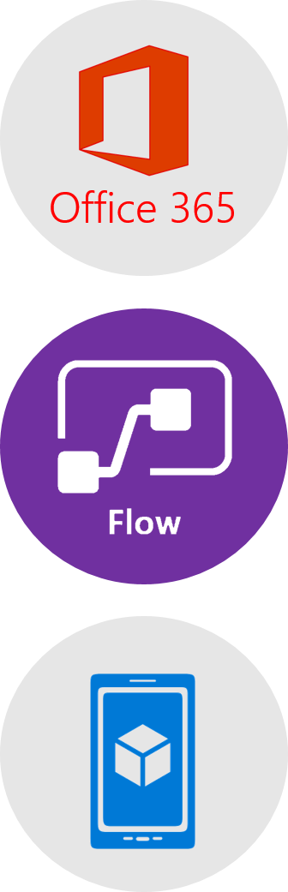
Preferred solution – 11
Extensibility
Business users can create an automated email workflow with Microsoft Flow in 3 easy steps:
Create a new flow that starts with Office 365, on new email with High priority.
Send a push notification action using subject and sender from email.
User would install Microsoft Flow app to receive notifications.
Notes:
This could be implemented with Microsoft Flow.
The business user would login to Microsoft Flow and create a new flow. It would begin with Office 365, on new email, where the priority flag is set to High.
Then a Push notification – send a push notification action would follow that can use the subject and sender of the email in the subject of the notification.
The user would save this flow. To receive notifications, the user would need to install the Microsoft Flow app on her mobile device.

Slide 50


Preferred objection handling
How can we automate our processes?
Will Microsoft Flow replace Logic Apps?
Is there really a way to securely store application secrets in the cloud?
How can we stay on top of a growing API ecosystem?
We won’t have all of the SQL features available to us in the cloud.
Which .NET framework should we choose?
Notes:
* Microsoft Flow allows business users to automate their processes.
* Flow will not replace Logic Apps. Logic Apps represent an “advanced” version of Microsoft Flow, providing support for more developer centric tasks, such as integrating API Apps as custom actions, whereas Flow only provides pre-built actions.
* Azure Key Vault provides a mechanism to store secrets encrypted and securely stored within the confines of specialized hardware called Hardware Security Modules (HSM). * A proof of concept that demonstrates the capabilities of Azure API Management can be put together quickly and can easily be scaled up to create the API Store experience Contoso is looking for.
* It is likely that a feature that was previously built into SQL Server and used from applications directly now runs external to Azure SQL Database in the form of a separate Azure service. Examples include:
Linked servers- are not supported by SQL Server, but cross database read-only querying is possible using elastic database query.
Database Mail- which was used to send email directly from SQL Server is not supported, but there are multiple alternatives (such as using Office 365 and SendGrid) that applications can use to send emails.
SQL Server Agent Jobs- these background processes can usually be migrated to a Web Job (running within an App Service), Azure Functions, or to Cloud Service Worker Role.
Service Broker- numerous alternative messaging options exist in Azure, including Azure Storage Queues and Azure Service Bus Brokered Messaging.

Slide 51
Customer quote
“Microsoft has done a brilliant job with the technology they have put into the cloud. Our Azure-hosted applications are modifiable, interoperable, and secure. We could not be happier running PolicyConnect on Azure.”
Charlene Mathis, General Manager, Contoso, Ltd.

Slide 52
Hands On Lab
Now it’s your time check out the hands on lab in the repository.
https://github.com/solidify/.NET-Modernization-In-a-Day

Slide 53
https://solidify.dev/
https://www.linkedin.com/company/solidify-dev
https://github.com/solidify
@solidifyse
https://www.youtube.com/channel/UChHumq_I3ne3nnoQ0B_KNgQ?sub_confirmation=1
Notes:
https://solidify.dev/
https://www.linkedin.com/company/solidify-dev
https://github.com/solidify
@solidifyse
https://www.youtube.com/channel/UChHumq_I3ne3nnoQ0B_KNgQ?sub_confirmation=1

